Slide 1

Presenting
your research
findings

Slide 2

Recap
Key points to remember;
  Graphs are a simple way to turn numbers into a visual form of information.
  Line graphs are made by mapping points on a grid using an x-axis (horizontal line) and a y-axis (vertical line).
  Analysing data means looking at your data and figuring out what it tells you. This allows you to discover if your hypothesis was correct or incorrect.
  To complete the Scientific Method, you must share your new knowledge with others!

Slide 3
Time to share what you have learned
Now that you have successfully completed the experiment, recorded and analysed your data, it’s time to share what you’ve learned with the world!
Using the research poster template in your Student Handbook, you can write up the experience of being a scientist.
You’ll have an opportunity to share your poster with your class and scientists who will be visiting your classroom!

Slide 4
Preparing your research poster
The poster template has 4 sections that you can fill out to share the details of your experiment. These are;
  Aim - what questions were you trying to answer?
  Results - what happened during the experiment? What did you observe?
  Procedure - what did you do? And why?
  Conclusion - did your results prove your hypothesis?
Notes:
i put this note in the handbook: i miss a section introducing the topic in which students could reflect about what they have learned. something like
"Introduction/State of the art
Seeds are very sensible to climate change. This is a big problem for seeds to germinate and farmers are worried about not producing enough food. Therefore, we need to find ways to help seed to germinate even if weather is not good"

Slide 5
Time to share what you have learned
Work with your research partner to complete all sections of the poster, including as much detail as you can.
This is your opportunity to show the observations you made, and the results of your analysis.
When you present your poster at the SeedPop! Scientific Conference, the poster will be your guide as you share all that you have learned.

Slide 6
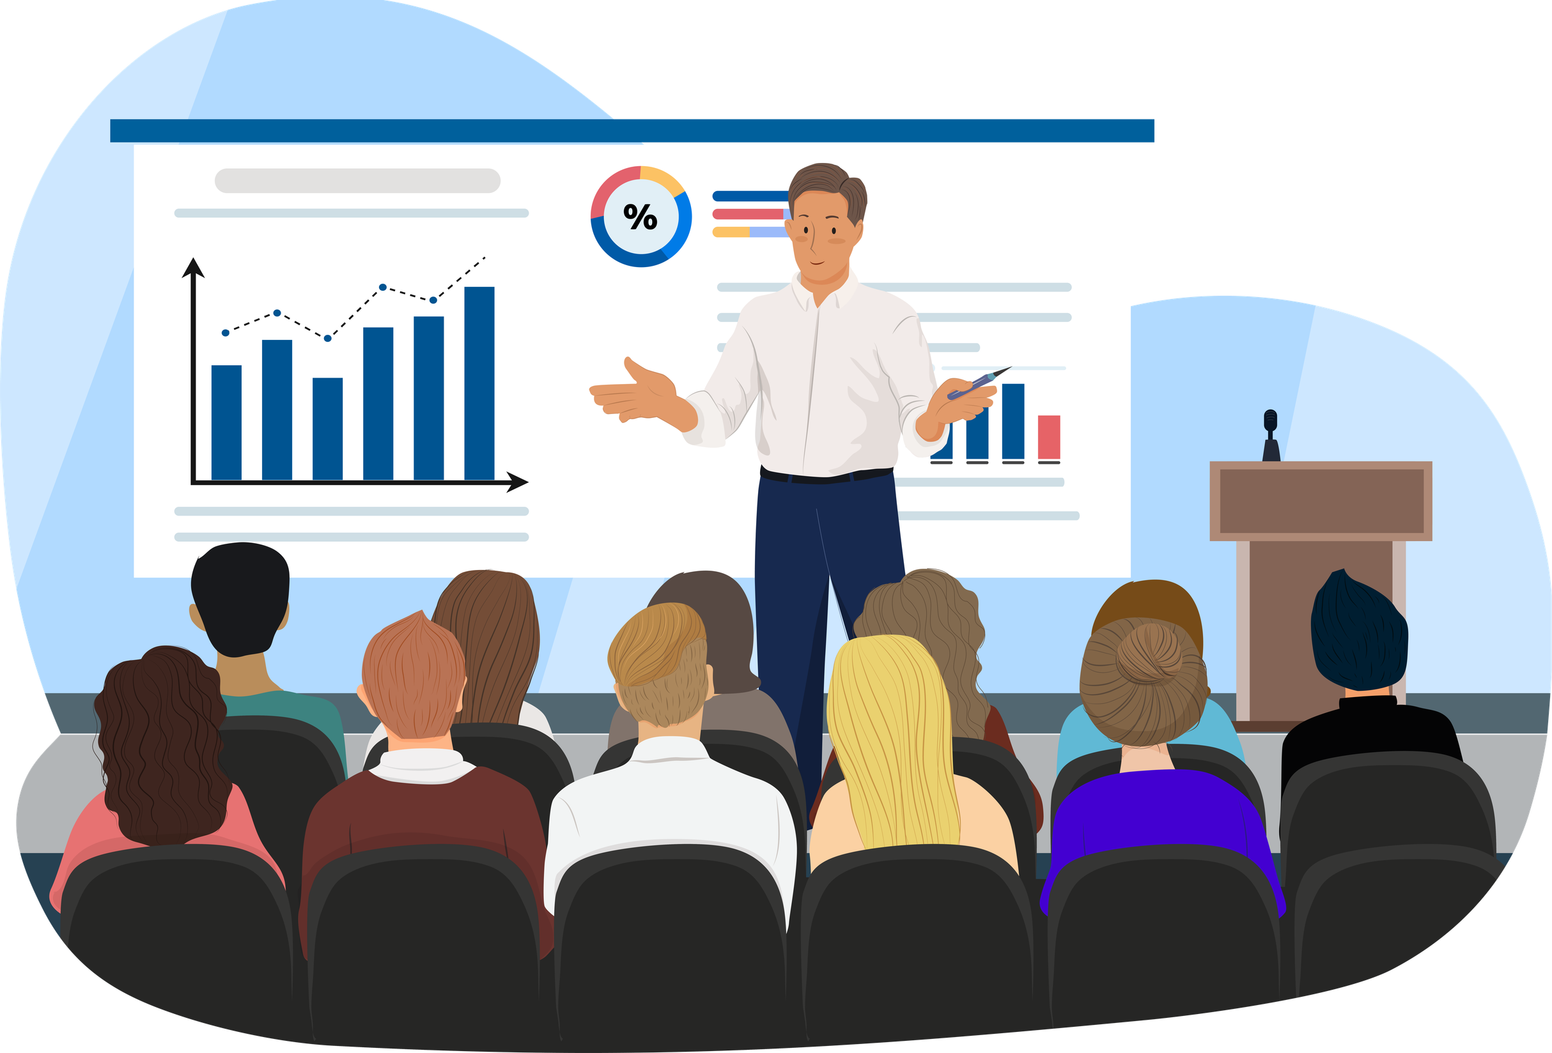
what is a scientific conference?
A Scientific Conference is a gathering of science researchers from around the world who meet to share and discuss the work they are doing in the lab. It is a great opportunity for scientists to learn from one another and find new colleagues to work with.
At the SeedPop! Scientific Conference, you and your partner will have a chance to share all that you have learned with a visiting scientist.

