Slide 1

Planning your
experiment
using the scientific method
Notes:
General comment: I like the session a lot! I am surprised because I was quite concerned about this being to hard for the kids, but I think that it can be quite fun!
I propose that we instruct the teacher's to pause at slide 9 to do the hypothesis worksheet.... giving time to really absorb that concept before moving on to the remainder of the method steps. Not sure if that is helpful or breaks momentum, so open to your ideas
uhmmm... I see your point and it makes sense because later the fellows talk more about how to organise the work working with colleagues while until slide 9 is more about the scientific method

Slide 2

Recap from Session one
Key points to remember on germination, plant stress and priming;
  Seeds are a vital part of our food supply and food security.
  Seeds need water, oxygen and the right temperature to germinate. Depending on the seed, light can also affect germination
  Seeds and young plants can experience stressful growing conditions. These stresses can affect germination and plant growth.
  Climate change can lead to more drought. In some areas, drought can increase the concentration of salt in the soil, making it harder for seeds to germinate and plants to grow.
  Scientists are experimenting with seed priming, which can help seeds germinate and grow under stressful conditions.
Notes:
change "seeds" in first sentence to bold

Slide 3
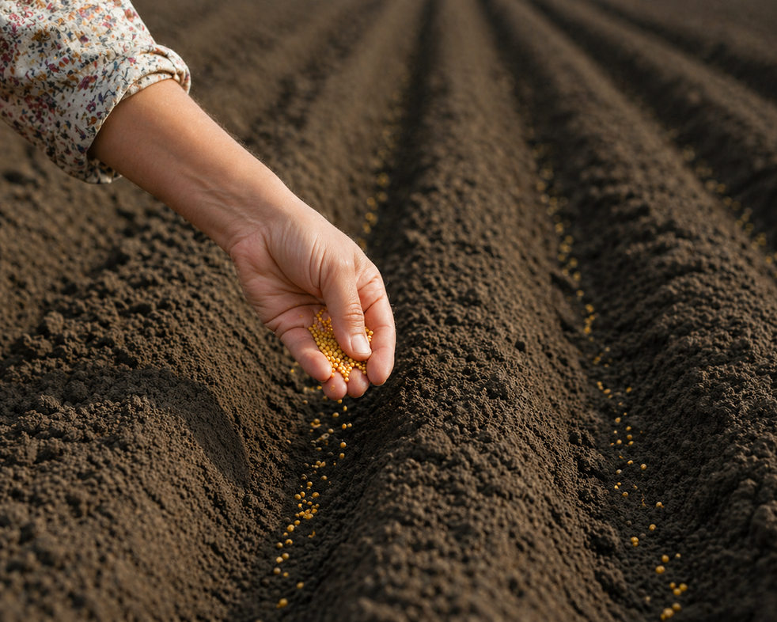
Planning your experiment
Now that you have learned about seeds, germination, plant stress and seed priming, it is time to plan your classroom experiment.
First, let’s look at one of the methods scientists use to plan and carry out experiments.

Slide 4
The scientific method
The Scientific Method is a way scientists learn about the world and solve problems. Scientists start with a question. They learn about the topic and use what they know to make a hypothesis: their best guess about what will happen.
Next, they do an experiment to test their hypothesis. They make observations and take measurements. Everything they record is called data.
Scientists look at what they recorded to find their results: what happened in the experiment. They use their results to make a conclusion and decide whether their hypothesis was right or wrong.
Finally, scientists share what they found with others.

Slide 5
The scientific method
#1
Ask a Question
#6
SHARE
your results
#2
Make a Hypothesis
#5
Analyse
DATA
#3
Conduct an Experiment
#4
Collect Data
Notes:
Muriel made a comment on the handbook about this slide and I agree that it is important: just after asking a question, and usually before making a hypothesis, there is an intermediate step of researching about your question. for instance, if the question is "how can i help seeds to germinate better?" the first thing will be to research what other people are doing or have done in the past to help seeds to germinate. this is a very important step because it helps us to refine the question and to avoid doing something someone else did before

Slide 6

Planning your experiment
Working in pairs, you will be running an experiment to see if priming seeds helps with germination under stressful conditions.
Let’s look at each step of the Scientific Method to help you plan your experiment and form a hypothesis.

Slide 7
Step #1
Ask a Question
Think about the challenge that climate changes are creating for Liam & Lisa on their farm.
What questions can you ask that might help find a solution?
Make your questions as specific as possible and ensure they are something you can test.
Notes:
can we add a big question mark on the left side of the slide?

Slide 8
Pause for a few minutes to discuss possible questions

Slide 9
Research questions
Some of the questions you might have come up with are;
How can scientists help farmers like Liam & Lisa to grow successful crops even when climate conditions cause drought?
Can priming a seed change its ability to germinate?
Does a primed seed germinate differently even in stressful conditions?

Slide 10

step #2
Make a Hypothesis
A hypothesis is best guess or proposed idea that you can test with an experiment to see if it is true.
To write a hypothesis, use the "If / Then / Because" method
IF [I do this action]...
THEN [this will happen]...
BECAUSE [the scientific reason why]
Notes:
aaaaah, you put the question mark here :)))))
"educated guess"... does it sound okay? or can we just say "a guess"?

Slide 11
Complete your
Hypothesis Worksheet

Slide 12
Research questions
Share some of your answers from the Hypothesis Worksheet with your classmates. Your hypothesis for the SeedPop! experiment might be similar to this...
IF we grow primed and unprimed seeds under two different environments (one salty water, one fresh water)
THEN the primed seeds will germinate faster and grow longer roots than the unprimed seeds
BECAUSE priming seeds makes them more resilient even when stressed.
Notes:
petri dishes is probably difficult for them to understand as they haven't seen the full protocol and material yet, so I changed it for "under two different environments".
i also changed unsalty water for fresh water

Slide 13
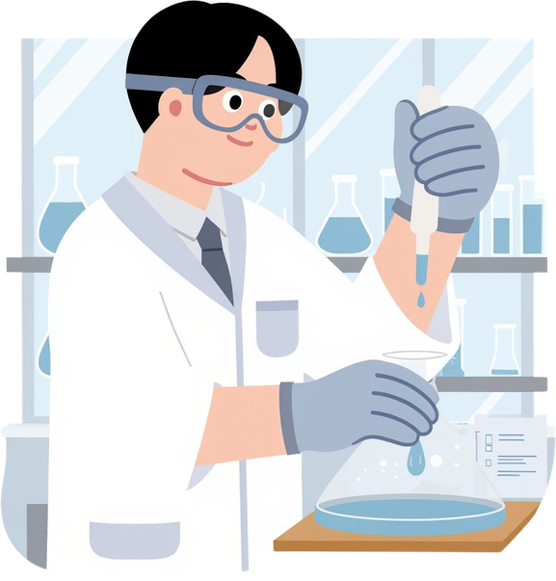
Conduct the Experiment
Step #3
STEP #3
The experiment will help you test your hypothesis.
Each step of the experiment is shown in your Student Handbook.

Slide 14
Next steps
We’ve looked at the first 3 steps in the Scientific Method.
You now have:
  research questions about the challenge Liam and Lisa face on their farm
  a hypothesis to test
In the next session you will set up and start your experiment!
The scientific method
#1
Ask a Question
#6
Share Your Results
#2
Make a Hypothesis
#5
Analyse
Data
#3
Conduct an Experiment
#4
Collect Data

Slide 15
Recap
Key points to remember;
  Scientists form their research questions to respond to real challenges faced by people or to learn something new about the world
  A hypothesis is an idea or possible explanation that can be tested through an experiment.
  By doing experiments, scientists often discover that their hypothesis is wrong- but that is not a bad thing- every failure teaches us something, and helps us move forward until we solve a problem.
Notes:
same here about educated guess
"by conducting, " do you mean "by conducting experiments"?
I think that the lesson is missing the possibility to discuss the last point a bit deeper with the students or is the "what happened if your hypothesis is wrong" part of other lesson?

